Slide 1
Diagonal Scoring
April 7 2026

Slide 2
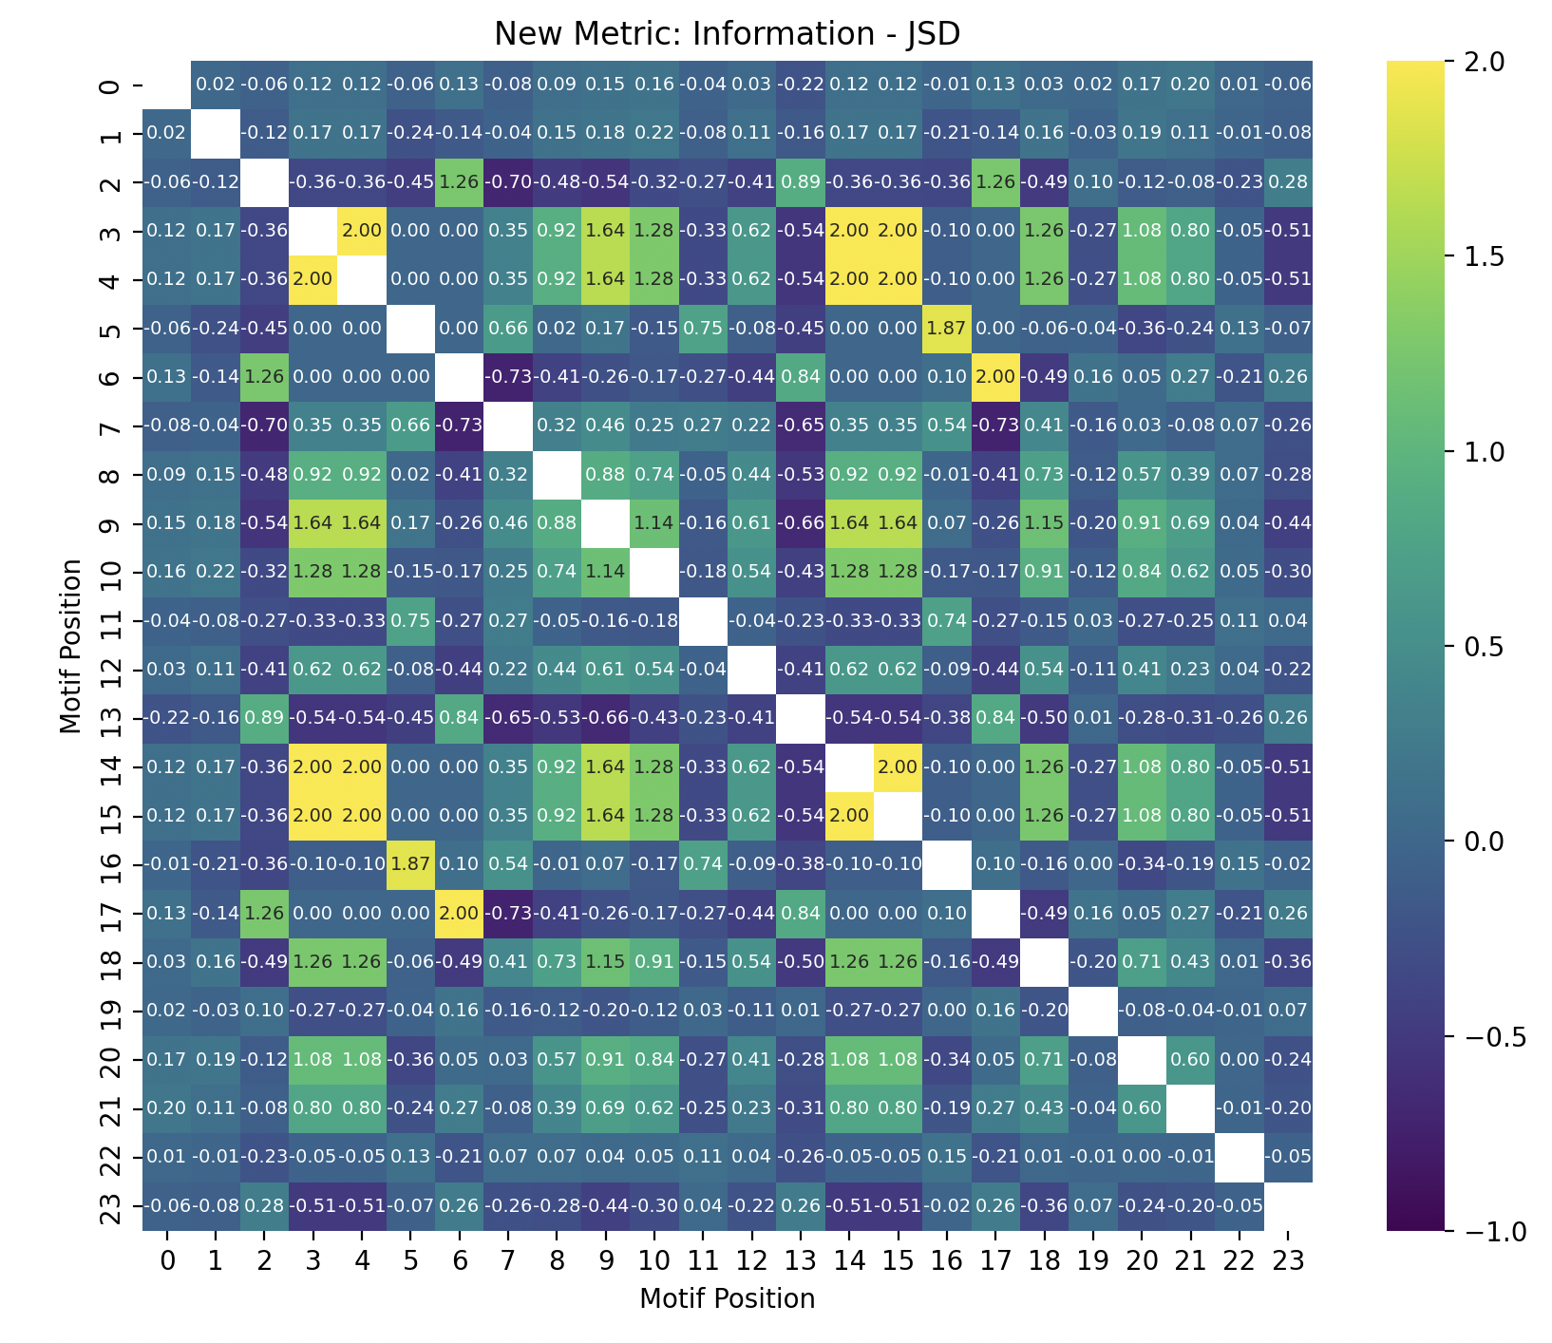
meme_out_2, motif 2

